Slide 1
Chapter 9
Output Analysis for
Single Systems

Slide 2
Chapter 9 Output Analysis – Single System
Reading: Chapter 9
9.1 Introduction
9.2 Type of simulations with regard to output analysis
9.3 Statistical analysis for terminating simulations
9.4 Statistical analysis for steady-state parameters
9.5 Other measures of performance related to a single system

Slide 3
Why Output Data Analysis?
Introduction
Why output data analysis?
  One realization (run) does not necessarily give the “correct” answer(s).
  Variance exists in simulation results so we must be cautious about how we interpret results
  Output from our model {Y₁, Y₂, Y₃, …}
  {Y₁, Y₂, Y₃, …} may not be independent;
  {Y₁, Y₂, Y₃, …} may have different distributions, depending on a number of different factors;
  Estimators, confidence interval, and so on, must be constructed.

Slide 4

If you remember nothing else…
A single run of a simulation model is always a really, really bad idea.
Don’t drop the simulated ball!

Slide 5

Example
We wish to estimate the sum of two dice.
We roll the die once and get a value of 5.
In reality, the average sum of two die is 7.

Slide 6
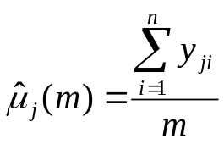
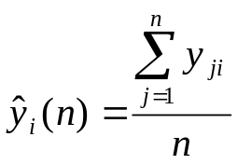
Simulation Replications
Introduction
Replications
  Run the simulation and sample from each run m times. Complete n runs:
  y₁₁, y₁₂, y₁₃, …, y_{1m}; (y_{ij} is called a realization of {Y₁, Y₂, Y₃, …})
  y₂₁, y₂₂, y₂₃, …, y_{2m}; Note that the observations along the rows are
   not IID, however observations down the columns
  are!
  y_{n1}, y_{n2}, y_{n3}, …, y_{nm}; ({y_{1i}, y_{2i}, y_{3i}, …, y_{ni}} from I.I.D. for Y_{i})
Estimators
  may not be a unbiased estimator of the mean
  (i.e. across the rows)
  is a unbiased estimator of EY_{i}.
  (i.e. down the columns)

Slide 7
Transient vs. Steady-State
Definitions
Transient: The period during which system state response is depends on the initial starting conditions.
Steady-state: System state after a long time – i.e. the system’s state is independent of the initial starting conditions.
Formally, consider the output of a stochastic process to be Y₁, Y₂, …
Let F_{i}(y|I) = P(Y_{i} <= y| I) for i = 1, 2, …,
where I represents the initial starting conditions.
At steady state F_{i}(y|I) → F(y) as i → ∞, that is as time heads towards infinity, the output of the stochastic process becomes independent of the starting conditions.

Slide 8
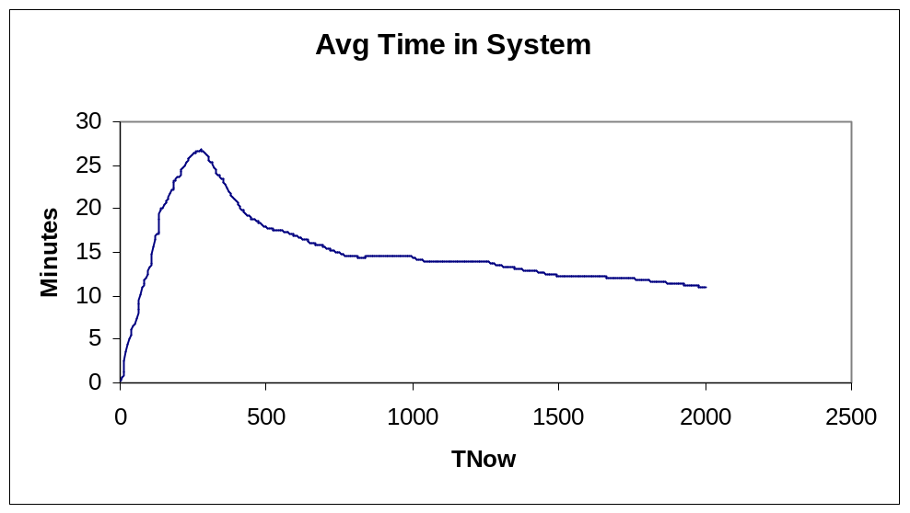
Transient Condition Example
Below, I have produced a plot of average time in system in an M/M/1 (ρ = 0.90) system. The observations are from a single run and are taken 5 minutes apart. The initial condition of the system was empty and idle.

Slide 9
So What?
Typically (though not always) we are interested in the steady state performance of the system.
If we include the transient, we get a different result than if we exclude it.
There are two ways to get around this issue:
  Run the model for a very long time (costly).
  Chop off the transient state (tricky).
Average including transient
Average excluding transient

Slide 10
Model Nomenclature
We generally use different techniques to analyze the results of simulations, depending on the type of model we’re running.
Types: Terminating simulation and Non-Terminating
Terminating simulation: There is a “natural” event that suggests a length for each run.
  Examples
    A inventory planning model with a fixed horizon.
    A Queuing System at the Bank.
Non-terminating: No natural event to end the model.
  Examples
    A plant that is open 24-hours per day and never empties.

Slide 11
Non-terminating Simulation
Non-terminating simulation: No natural event terminates the simulation process. In general, we may be interested in a range of performance parameters from non-terminating systems:
  Steady-state parameters
  M/M/1 System: Average queue length
  Steady-state cycle parameters
  Manufacturing plant: output per shift / per day / per month
  Other parameters: A system that is a constant state of change, for which no steady-state exists. For example, a system in which the arrival rate is constantly changing.

Slide 12
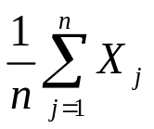
Terminating Systems: Estimating The Mean
Statistical analysis for terminating simulations
We make n independent replications using a particular model and a common set of initial conditions. For replication j of that model,
  define X_{j} = a random variable defined on the j^{th} replication.
  {X₁, X₂, …, X_{n}} are independent and identically distributed.
  Let X be the random variable of interest. We want to estimate EX.
Examples
  M/M/1: Waiting time {D₁, D₂, …, D_{m}} ⇒ Mean X = (D₁+D₂+ …+D_{m})/m.
Intuition: Calculate the measure of interest (X) for each replication ⇒ X_{j}, 1≤j≤n. Consider the results from each run to be a sequence of independent random variables {X₁, X₂, …, X_{n}}.
Calculate E(X) as

Slide 13
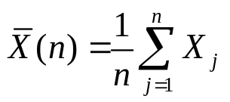
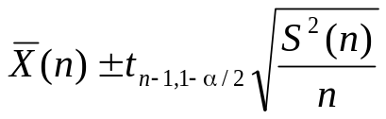
Estimating the Mean and the CI
Point estimate for the mean:
Confidence interval for the mean
Where S²(n) is the sample variance.
This method of determining the CI is known as the fixed sample-size procedure, since we fix the sample size ahead of time.

Slide 14
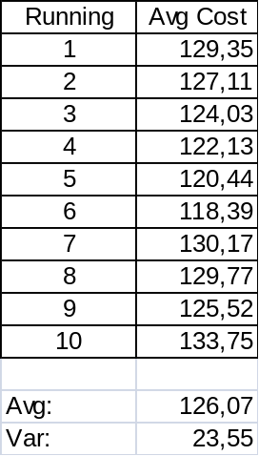
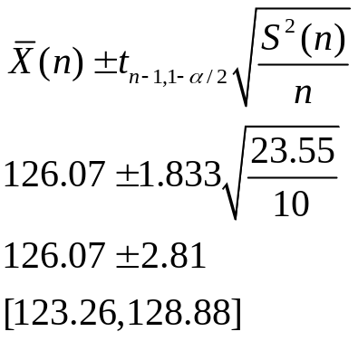
Example 9.15
For a particular inventory system, suppose that we want to obtain the mean and 90% confidence interval (α = 0.10) for the expected cost over a 120-month planning horizon. We make 10 running of 120 months.
t_{n-1, 1-α/2} → t_{9, .95} = 1.833

Slide 15
A Word of Caution about Confidence Intervals
In 9.4.1 Law and Kelton show that confidence intervals may be inaccurate if the number of replications is small, or the shape of the underlying distribution is highly skewed
  They use an M/M/1 with ρ =0.9 and calculate the average delay in the system for the 1st 25 customers.
  The true mean for this model is known to be 2.12.
  They then conduct 500 experiments using different numbers of replications (n=5, 10, 20, 40) to build 90% confidence intervals.
  They then determined the proportion of these experiments in which the confidence interval suggested by the simulation covered the actual mean.
  NB: Remember that if we are using a 90% confidence interval, we would expect that the 90% of the time the true mean should be contained within the confidence interval.

Slide 16
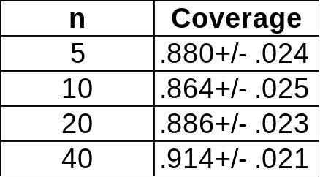
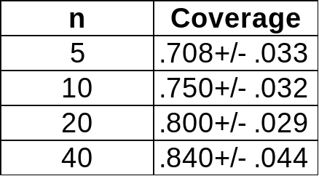
Confidence Interval Test
M/M/1
For the M/M/1 test, L & K found that the CI generated from the simulation had slightly less discrimination than would be assumed.
E(Fail|New Components)
They also ran a second test on a simulation of a system with three components in which they measure the time to system failure where failure is Min{G₁, Max{G₂, G₃}}, where G_{i} is the failure time of component i.
Failure distributions were assumed to be Weibull(0.5, 1), which is extremely skewed.
Bottom line: A good number (>30) is typically needed to meet assumption of normally distributed output. More if the underlying distribution is skewed.

Slide 17

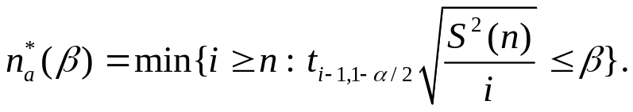

Specified Precision: Absolute Error
Sometimes we will want to run the simulation for “enough” replications to achieve a given level of precision in our CI
Prespecified precision Find n so that
where β is a fixed number.
Assume that we have already done n trial replications. Let
Then approximately we need to have - n additional replications to achieve the pre-specified precision.
S²(n) is assumed to be close to Var(X).

Slide 18
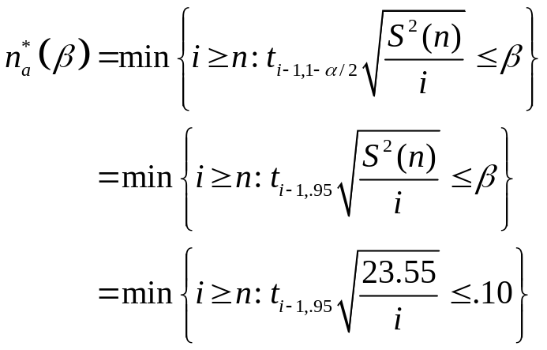
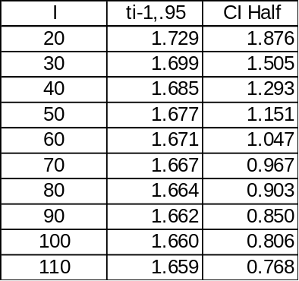
CI: Absolute Error Example
Let’s say that in our example (9.15) we desired to have an absolute error of no more than 0.80 of a minute with a 90% confidence level.
Trying different values of i:
We see that a total of 110 observations are needed. Since we’ve collected 10 already, we would simply collect 100 more.

Slide 19
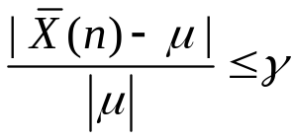
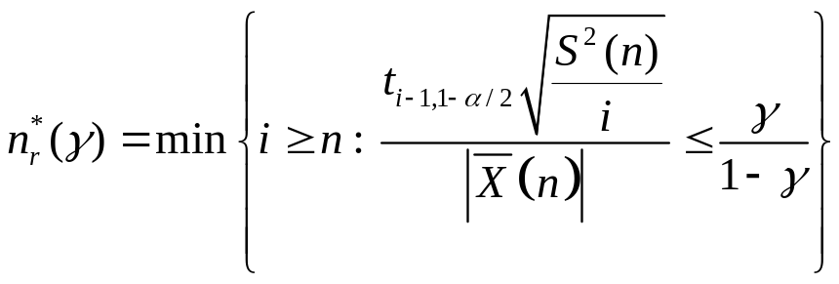

Specified Precision: Relative Error
Sometimes we will want to run the simulation for “enough” replications to achieve a level of precision related to our mean
Relative precision Find n so that
where γ is a fixed proportion.
Assume that we have already done n replications. Let
Then approximately we need to have - n additional replications to achieve the pre-specified precision.
γ’= γ/1-γ is called the adjusted error

Slide 20
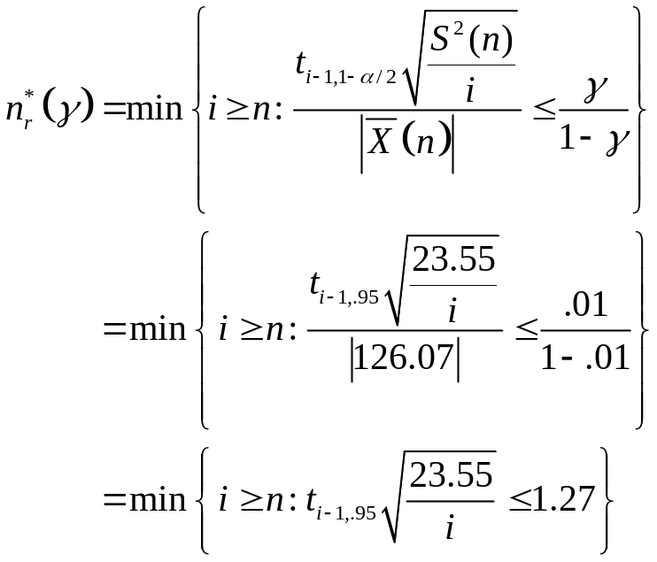
CI: Relative Error Example
Let’s say that in our example (9.15) we desired to have an relative error of no more than 1% with a confidence of 90%.
Trying different values of i:
We see that a total of 50 observations are needed. Since we’ve collected 10 already, we would simply collect 40 more.

Slide 21
Choosing Initial Conditions
One question that arises in a terminating simulation is the correct selection of an initial starting condition.
1) “Warm-up period”
  Run the simulation program for a while, discard all the data obtained up to the point, and use only the data collected after this point.
  For example, say that we are interested in simulating the operation of a bank between 12:00 and 1:00.
  We could start the simulation at 9:00 with no customers in the system and then throw out all of the statistics collected before 12:00.
2) With a specific initial distribution
  We could assume that with P{q(0)=j} = ρ(1-ρ^{j}), there are j customers in the system at time 12:00. We might randomly select j for different runs.

Slide 22
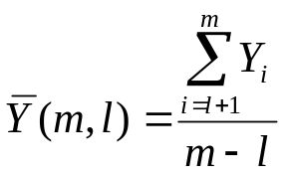
Steady-State
Statistical analysis of steady-state parameters
Define X = (Y₁, Y₂, …, Y_{m}). We are concerned with what occurs from time 1 to m. For instance, we want to estimate EX throughout a simulation run.
But, in general, we would expect that observations at the beginning of the run are unlikely to be representative of the steady state and might bias our simulation unless we do very, very long runs.
So, to shorten our run length, we’ll set up a “warm-up period” for our model:
  Idea: to delete some number of observations from the beginning of a run.
  An estimator of EY: , in which {Y₁, Y₂, …, Y_{l}} are not used.
  Examples The M/M/1 queue, waiting time D₁, D₂, …, D_{m}, → D.
  Inventory model, total cost per month C₁, C₂, …, C_{m}, → C.
  Question: How to determine l?

Slide 23
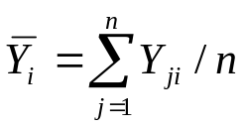
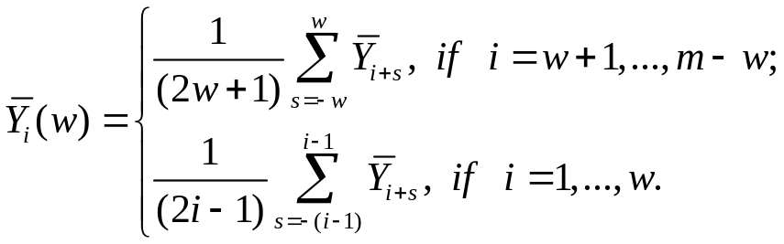
Welch: Moving Window Method
Welch’s procedure
  Make n replications and take m observations (m is large): Y_{j1}, …, Y_{jm}.
  Let . We obtain a sequence of averages.
  Moving window: A moving average centred on i.
  Plot the sequence. Choose l such that the plot is relatively smooth after this point.
  Try different values of w. When w is small, the plot may be “ragged”. When w is large, the plot may be over-aggregated.

Slide 24
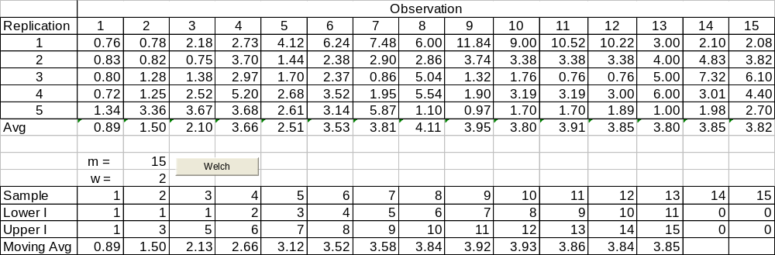
Welch Example
Assume the following output from the 1st 15 simulated hours of a particular model.

Slide 25
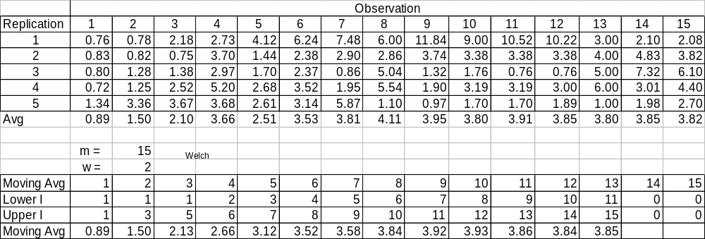
Welch Example
Students always have trouble with the subscripts in Welch. But note: The moving average is simply a moving average of 2w centred on i. If i-w is less than 1, we simply set 1 as the lower limit and adjust the upper limit so we have a symmetric window. We stop at the point where the upper limit (i+w) = m.

Slide 26
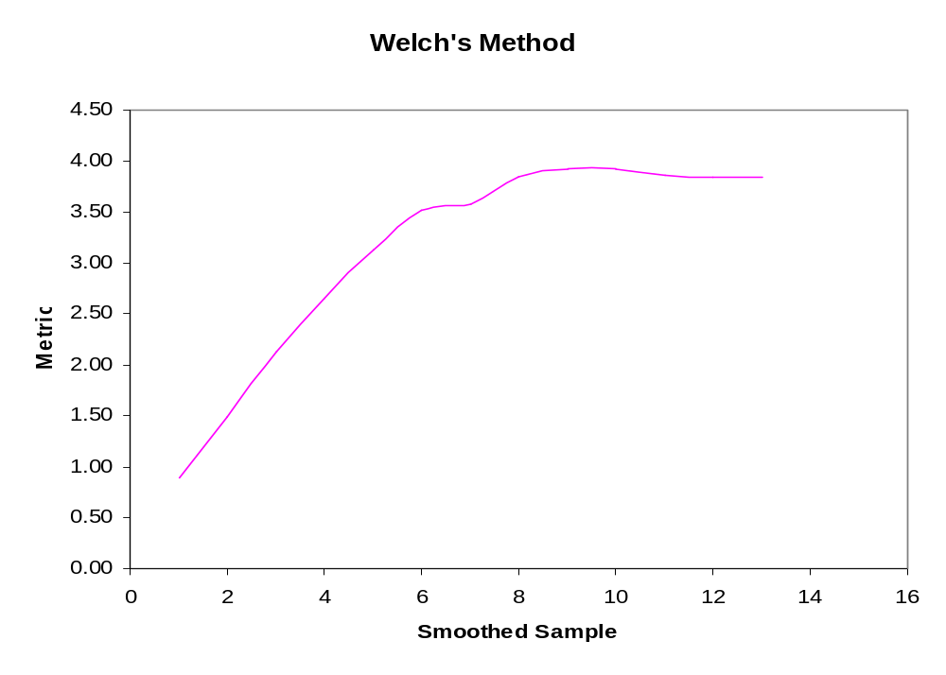
Welch’s Method Example
In this example we would probably select t = 9 as the end of the warm-up period

Slide 27
Approaches for Means
Assume that we want to determine some measure from a simulation
  Replication/deletion method
  Batch means
  Autoregressive
  Spectral
  Regenerative
  Standardized time series
Each procedure has some statistical strengths and weaknesses.
The replication/deletion method is easy and widely used as is the method of batch means.

Slide 28
Replication/Deletion Method
Transient
Steady State
We delete the transient and calculate an instance of our metric over the steady state of one replication.
…
Transient
Steady State
We do n replications. We then average our metric over the n runs that we did!

Slide 29
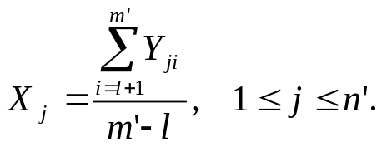

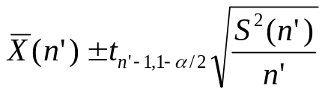
Replication/Deletion
Conduct a number of trial runs to identify the transient state.
Make a further n’ independent replications. Choose the length of the run to include m’ observations (where m’ is much larger than l, the number of observations collected during the transient).
Delete (clear) the statistics after the transient for each replication
Record the metric of interest for each replication
Use these results to estimate EY by averaging across the runs.
  Performance measure:
  Approximately unbiased point estimator:
  (1-α)% confidence interval:

Slide 30
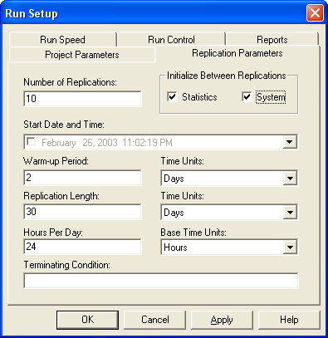
Implementing Delete/Replicate in ARENA
10 Replications.
System is initialized between replications.
Statistics are cleared after day 2 on each replication.
Each replication will be 30 days long, including replication (i.e. the reported period will be 28 days)

Slide 31
Batch Means
Make a single long run and collect instances of a metric {Y₁, Y₂, …, Y_{m}}. You generally delete the initial transient.
Divide these into n batches of length k:
  {Y₁, Y₂, …, Y_{k}}, {Y_{k+1}, …, Y_{2k}}, ...
Take the average across each batch as a single observation of the metric.
If k is large enough, the batch averages will be approximately uncorrelated and the batch average will be normally distributed.
Take the average across all batches and report this as E(Y).
Batch means saves time in the sense that the transient only has to be run once.
However, it can be a bit tricky to determine the proper length of the batches.

Slide 32
Batch Means
Transient
Steady State
Take average within each batch
Take the average of the averages

Slide 33

Implementing Batch Means in ARENA
10 Replications.
System is not initialized between replications.
Statistics are cleared after day 2 on 1st replication.
Each replication will be 30 days long, including 1st replication.

Slide 34
Steady State Cyclic
Hourly Throughput
Time
Note that this metric probably doesn’t have a steady state
If we take the average across the cycle, we might reasonably expect the cycle average to come to steady state
We will average the cycle averages to estimate the measure of interest.

